Slide 1
Supporting Students and Families with Complex Immigration Statuses in Postsecondary Planning
The MEFA Institute

Slide 2
How to Participate
The Audio Settings allow you to control the volume levels
Use the Live Transcript feature if you want to see closed captions
Click Leave to exit the webinar
The Chat feature is disabled. To communicate with the host, please use the Q&A section
Have a question during the webinar? Type it in the Q&A section

Slide 3
About MEFA
State authority created by the Commonwealth of Massachusetts in 1982, helping families plan, save, and pay for college
Notes:
MEFA has a public service mission to help families navigate planning for college
Bookmark mefa.org, follow MEFA on Facebook, Twitter, and LinkedIn, and sign up for MEFA emails on mefa.org)
All webinars can be found at mefa.org/events

Slide 4
Webinar Topics
Grounding Ourselves
The Larger Context
Self-Disclosing Safely
Tactical Resources
Notes:
Agenda slide – introduce the topics to be discussed during the seminar

Slide 5
Grounding Ourselves for This Work
Your story of allyship is important
Acknowledge your awareness/knowledge level
Lean into growth
This topic is hard, it’s OK to feel all sorts of emotions while helping students and families

Slide 6
3 Grounding Best Practices By a school counselor for school counselors
1) Know your community
Work to ensure every counselor, general teacher, ELL/ESL teacher, coach, adviser, and administrator has a baseline knowledge general local landscape
Your hyper-local context will impact how you do work at your school and organization
2) Self-disclosure is important in order to maximize resources and time for your college applicant students!
Even if they’re not undocumented, some may have a non-citizen status or come from a mixed status family, which may impact their financial aid process
3) Model talking about immigration especially around the college app process and be open
Myth bust whenever possible!
Don’t stay silent… but also, no answer is better than the wrong answer.
Don’t be afraid to say, “I don’t know, but you know what, I’m on this journey with you and we’ll figure it out. I will make sure we get an accurate answer for this!”
Get ready to GET CREATIVE

Slide 7
Self-Reflection Questions Bring these back to your teams/schools!
What countries are mostly represented in our school/organization?
Are there statuses that are more prevalent from certain countries? (e.g. TPS)
Do we have a large population of undocumented students?
Which colleges around us are more undocu-friendly?
Which colleges give more merit aid to students who may not be undocumented but not eligible for Title IV (FAFSA funds)?
Best practice: Centralize your undocumented student support (someone that can coordinate and triage self-disclosures)
Note: Trends change fast! Always put it in the state/federal context

Slide 8
What is the Larger Context?

Slide 9
Useful Statuses and Terms
U.S. National
Naturalized citizen
Asylum granted
Asylum pending
Refugee
TPS
Permanent resident
Conditional permanent resident
Humanitarian Parole
*Note the role of the Paper I-94 vs the computer-generated Form CBP I-94A
Processes for Cubans, Haitians, Nicaraguans, and Venezuelans (CHNV) (offers humanitarian parole ***
Cuban/Haitian Entrants (this designation allows eligibility to many Federal benefit programs)
U visa
J and F visas
T visa
Other temporary visas
DACA
Family-sponsored visas
VAWA self-petitioner
Special Immigrant Juvenile Status
Undocumented (a lack of status)

Slide 10
Which Are Eligible for Federal Financial Aid?
U.S. National
Naturalized citizen
Asylum granted
Asylum pending
Refugee (with permanent resident card)
TPS
Permanent resident (I-551, I-151, or I-551c, etc.)
Conditional permanent resident
Humanitarian Parole***
*Note the role of the Paper I-94 vs the computer-generated Form CBP I-94A
Processes for Cubans, Haitians, Nicaraguans, and Venezuelans (CHNV) offers humanitarian parole***
Cuban/Haitian Entrants (this designation allows eligibility to many Federal benefit programs)
U visa
J and F visas
T visa
Other temporary visas
DACA
Family-sponsored visas
VAWA self-petitioner
Special Immigrant Juvenile Status
Undocumented (a lack of status)
Note: Those within the eligible statuses fall under the category of “eligible non-citizens” for FAFSA eligibility purposes

Slide 11
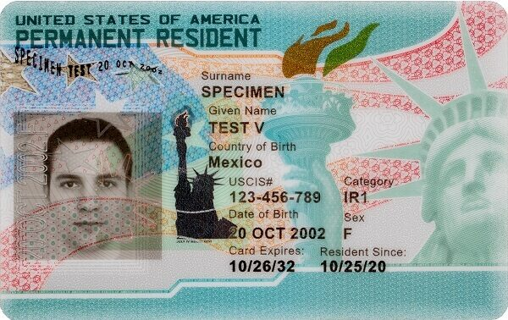
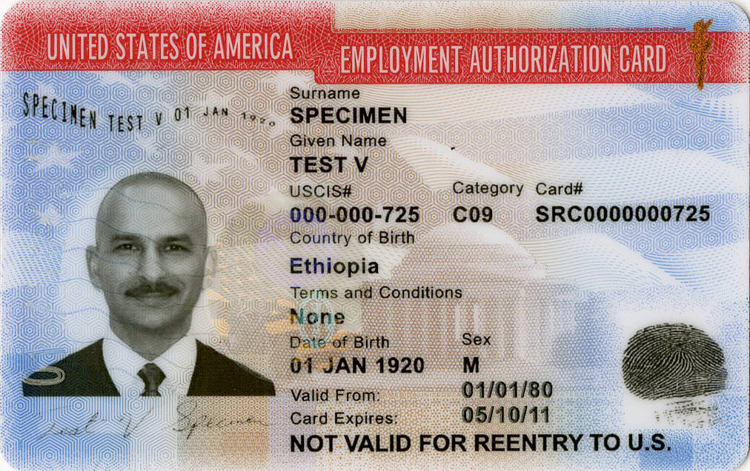
Differences Between Cards
Both these cards give the holder a USCIS#, but only one makes its holder eligible for federal financial aid (the Permanent Resident Card) (USCIS# is otherwise (formerly) called the A# or ARN).

Slide 12
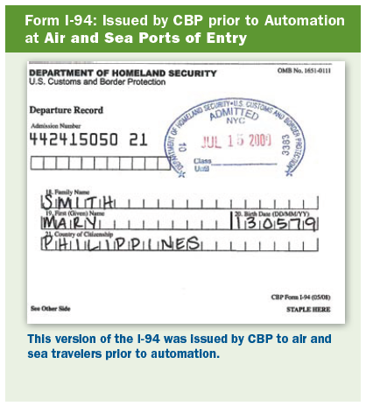
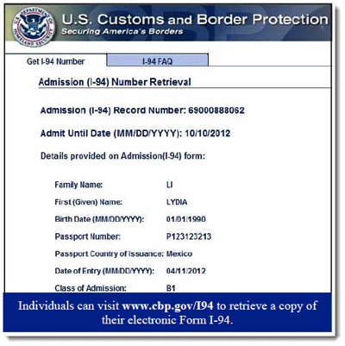
Become Familiar with the I-94
The I-94 Arrival/Departure record comes in electronic form now (some people might still be in possession of a paper version)

Slide 13
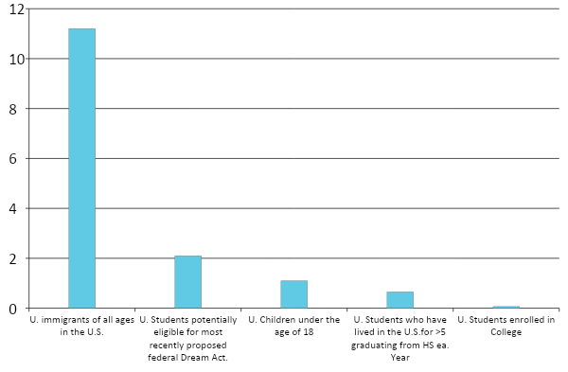
Why Self-Disclosure Matters
This graph shows national figures.
The Higher Ed Immigration portal has in-depth state data. See the Massachusetts numbers.
Only about 12,000 people are eligible for DACA in MA, from the almost 1.2 million immigrants in MA. The pool is getting smaller and smaller…this is why tuition equity is so important.
Data adapted from PEW Center figures

Slide 14
Financial Aid Reminder
Who is eligible for federal financial aid and who is not?
Remember, the list of who IS ELIGIBLE is way smaller than who is ineligible.
Because there are many statuses out there, make sure you fact find thoroughly with your student after they self-disclose to make sure you know exactly what their status is.
***Many students might actually not be sure. It’s best to engage them here, to fact find.
Check out example documentation in the IFAP (for College financial aid administrators) and when in doubt, check in with the financial aid office!

Slide 15
What Does This Mean for the…
Only students with an SSN and considered “eligible non-citizens” may apply.
If a student filling out FAFSA has one or two undocumented parents:
New users who request a StudentAid.gov account and cannot validate their identity using the knowledge-based questions (as generated by TransUnion) must still complete the manual process to validate their identity. However, they will not have to wait to have their identity validation completed before they can use their account username and password to access and complete the online 2024-25 FAFSA form.
FAFSA? CSS Profile?
All Students may apply. Encourage your students to be honest about their status in the “Explanation/Special Circumstances Section.”
For Institutional aid only.

Slide 16
Self-Disclosing Safely

Slide 17
Why Is It Important?
Self-disclosure is important in order to maximize resources and time for your students, regardless of what postsecondary path they’re pursuing
People who immigrate to the U.S. may have varied immigration statuses (or lack thereof) and/or be in a “mixed status” family… this may impact their financial aid process
The earlier you know, the timelier the resources and help will be (for example, they won’t miss any financial aid deadlines)

Slide 18
How Can It Be Done Safely?
Educators can never ask a student or family what their immigration status is
But once students self-disclose, counselors should feel like they can bring it up respectfully and when appropriate as needed for the college process
If you suspect there might be an immigration concern, use open-ended questions like, “Is there anything else you want to share what me that might allow me to help you in your process?”
Avoid writing emails with sensitive information at all times, but especially before a student or family has given permission to spread the information to others regarding their status
Share information with only staff that need to know (e.g. a fellow school counselor if you need a thought partner) and do it in person!
Do not keep a written list anywhere of student statuses when it includes first/last names + status in the same place. Major no!

Slide 19
Any Ways to Make Self-Disclosure Easier?
Students need to feel safe and supported in an authentic way by their counselors and trusted adults. It’s OK if you don’t know everything, but you must make sure they know you’re on their side and with them on this journey
Set the scene – visual cues of your allyship matter too!
Favianna Rodriguez 2013
Poster by ImmSchools.org

Slide 20
Model Openness and Inclusivity
Talking about immigration especially around the college app process should be something educators are open about
Our instinct is to protect our students and therefore be “very discreet” to the point sometimes of avoiding the topic directly, but this does not serve students applying to college
The earlier we talk about it, especially counselors, the more resources we’ll have when helping students apply to college
Peruse resources like these on statistics by state + access to financial aid and show them to your students too!
Higher Education Immigration Portal
The Education Trust comprehensive tool
Include resources about Tuition Equity, MASFA, and MassEducate in all your student and family-facing resources

Slide 21
Tactical Resources

Slide 22
General Advice for 4-Year College Applicants
1. There is no federal law that prohibits any immigrant with any immigration status from applying to or attending higher education institutions.
2. As you’re making a student’s college list, focus on colleges that offer immigrant-friendly spaces and support. If they have a DACA/undocumented student office/space, that’s a great sign!! * College-specific policies are constantly changing! When in doubt… ask!
3. Encourage your students to be honest about immigration status. Colleges are prohibited from releasing information unless under court order. FERPA protects this student right. Share this with students/families who might be hesitant to share information with colleges.
4. Students and counselors should connect with someone in the admissions office/scholarship office who works with multicultural students: an immigrant on a visa may to some admissions or financial aid offices be viewed the same as an international student. Fact find at each college! Many students who attended high school in the US may ask to be exempt from the TOEFL.
5. Talk openly about students’ interests and openness to living at home and commuting vs living on-campus. Depending on the college, it may be more affordable to live at home, especially at colleges that do not meet full need.

Slide 23
Tuition Equity Arrives in Massachusetts!
What is it? | Requirements
Extended in-state tuition and financial aid to undocumented students. Student has to establish that they are: A U.S. citizen, lawful immigrant, or permanent resident of the United States OR A Massachusetts resident; students will be verified under the status of “High School Completer”; this is NEW terminology under the Tuition Equity Law | Students must meet following criteria: Attend high school in the Commonwealth for no less than 3 years (“High School Completer”) Graduate from a high school in the Commonwealth or earn the equivalent Sign and submit a paper affidavit stating their intent to apply for citizenship within 120 days of eligibility. This is a legal requirement
To apply for MA state aid, students must submit Massachusetts Application for State Financial Aid (MASFA), the form by which the MA Office of Student Financial Assistance (OSFA) and MA public colleges will acquire household financial information about students

Slide 24
MassEducate: FREE Community College in MA
What is it? | Requirements
For any student with no previously earned bachelor’s degree Covers all course-related tuition and fees for eligible courses (does not cover program-specific fees for testing, materials) Offers a stipend of up to $1,200 per academic year ($600 per semester) for books and supplies to any student (Pell-eligible students receive another $1,200) | Complete the FAFSA Students not eligible to complete the FAFSA and approved as a “High School Completer” can complete the MASFA and still attend for free Enroll in at least six credits (usually two classes) per semester in an approved program of study leading to an associate degree or certificate Maintain satisfactory academic progress in accordance with college requirements

Slide 25
MASFA
Information courtesy of OSFA:
The MASFA is only available electronically. Paper applications are not available.
The MASFA application(s) is available via the Student Experience Portal. The application collects information to help determine student eligibility for state and institutional financial aid programs.
It is important that the student read each question carefully, before providing answers. Please note that answers to certain questions may qualify the student to skip other sections on the form. [i.e., Special Circumstances, Parental Information]
At the end of the application, the form will require the student (and parent, if student is a dependent) to review and sign the application. Selecting the ‘E-Signature’ is the PREFERRED option in order for the form to automatically calculate a student’s SAI (2024-25 form). Selecting ‘Paper-Signature’ will require a manual review of the signed form by the Massachusetts Office of Student Financial Assistance before an EFC or SAI can be calculated.

Slide 26
Scholarship Resources
Immigrants Rising | Dreamer’s Roadmap App | MALDEF
Scholarship resource guide PDF with an interactive filter tool | Intuitive app designed by and for undocumented students | A great, inclusive list of scholarships that do not require citizenship status to apply
https://immigrantsrising.org/resource/list-of-scholarships-and-fellowships/ | https://dreamersroadmap.org/scholarships | https://www.maldef.org/resources/scholarship-resources/

Slide 27
Stay Informed and Next Steps
Search for the closest Immigrant and Refugee Coalition to you, as local is best when pointing specific families to trusted legal aid. In Massachusetts, it’s MIRA!
Refer to trusted legal sources online like
Catholic Legal Immigration Network
National Immigration Law Center (linked earlier too!)
The Immigrant Legal Resource Center has the red “know your rights cards” available
Know about IMMIGRANT-led organizations and advocacy groups
One of the longest running is UNITED WE DREAM. The organizers there were the backbone of the early 2010s push for reform that brought forth DACA.
They have a definitive Know your Rights Guide
Immigrants Rising (originally started by educator allies) and has great resources, including a great “independent contractor guidebook”!)
ImmSchools - a wonderful new immigrant-led organization with great toolkits for educational organizations; see post in an earlier slide

Slide 28
Connect with MEFA on Social Media
facebook.com/mefaMA
linkedin.com/company/mefa
@mefa_ma
youtube.com/MEFAcounselor
@MEFAtweets
mefa.org/mefa-podcast
Notes:
Stress to families how active MEFA is on Twitter and Facebook, and that we have several helpful videos on YouTube.
Also mention to families that we answer questions on Facebook and Twitter, and it’s helpful for families to see the questions of others and the answers from MEFA, so we encourage using that avenue

Slide 29
Thank You!
(800) 449-MEFA (6332)
collegeplanning@mefa.org
Questions?
akeenan@mefa.org

